Slide 1


Immersive Python Workshop
August 15-16, 2024
Introduction to Sentiment Analysis
Ian Goodale
European Studies Librarian
Karina Sánchez
Scholars Lab Librarian
Presented by the
UT Libraries &
Open Source Program Office (UT-OSPO)
UT-OSPO
UT Austin Open Source Program Office
Sloan grant number: G-2023-20944

Slide 2
Overview
Introduction
Key Terms
Challenges
Common Approaches
Technology We’ll Use
Survey of Other Tools
Coding Exercises

Slide 3
Introduction
What is sentiment analysis?
Sentiment analysis provides a quantitative assessment of the emotional intensity of words and phrases within a text. Sentiment analysis tools generally process a given unit of text (a sentence, paragraph, etc.) and output quantitative scores or classifications to indicate whether the algorithm being used considers that text to convey positive or negative emotion. The tools we will use today can also quantify the degree of positivity or degree of negativity within a text.
In short, sentiment analysis offers us a way to quantitatively assess the emotions expressed in a written form

Slide 4
Introduction (cont’d)
Why perform sentiment analysis?
Analyze large amounts of data and return an easily understood output
Gain new insights into a dataset
Generate new ideas for analysis of a dataset
Produce visualizations

Slide 5
Key Terms
Rules/lexicon-based analysis: A type of analysis that pre-categorized lists of words and phrases (lexicons) to label the words (e.g. positive, negative, or neutral) and detect sentiment.
Machine learning based analysis (e.g., the Naive Bayes algorithm): A type of analysis that uses algorithms trained on pre-labeled texts to infer the sentiment of a given dataset of unlabeled text(s).

Slide 6
Common Challenges
(In)accuracy of the technology
Working with imprecise or complex textual data
Multilingual texts

Slide 7
Common Approaches
Using a pre-trained model available from an existing package
Training your own model
Different technological approaches:
Machine learning
Example: the Naïve Bayes classifier
Rules-based models
Example: Vader, which uses both lexicon and linguistic rules for sentiment classification

Slide 8
Technology We’ll Use
Pandas
NLTK
Including its Naïve Bayes classifier, Vader sentiment analysis package (rules/lexicon-based), and tokenizers
TextBlob
WordCloud
Matplotlib

Slide 9

Pandas
An open source data analysis and manipulation tool for Python
Uses a data structure called a data frame
These can be easily constructed from imported files (e.g., a JSON or CSV file)
It also allows for easily manipulation and analysis of the data in these DF structures

Slide 10
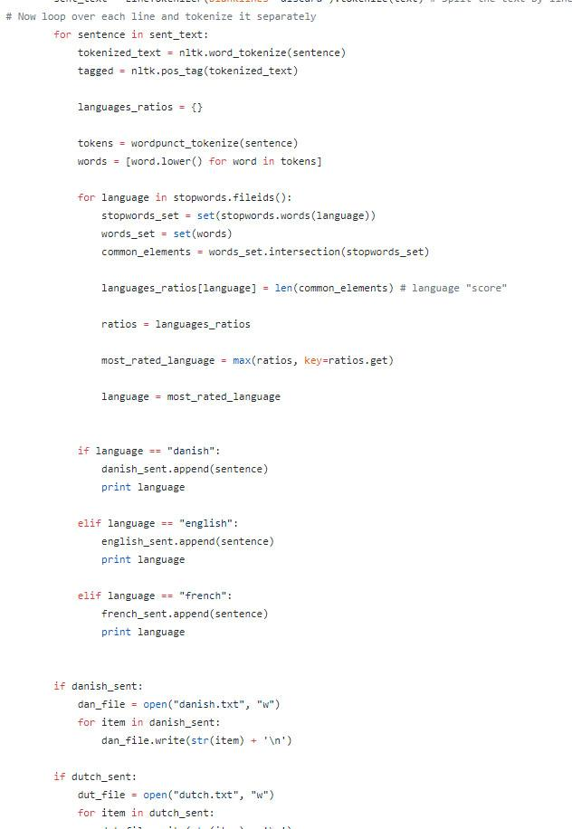
Natural Language Toolkit (NLTK)
Platform for building Python programs to work with language data
Large amount of corpora and lexical resources in addition to Python libraries
Great documentation makes this easy to learn and experiment with
Can easily be used with other Python libraries and tools

Slide 11

TextBlob
TextBlob is a Python library for processing textual data. It provides a simple API for diving into common natural language processing (NLP) tasks such as part-of-speech tagging, noun phrase extraction, sentiment analysis, classification, and more.
Its sentiment analysis functionality is easy to use, and utilizes the Naive Bayes algorithm
https://textblob.readthedocs.io/en/dev/

Slide 12
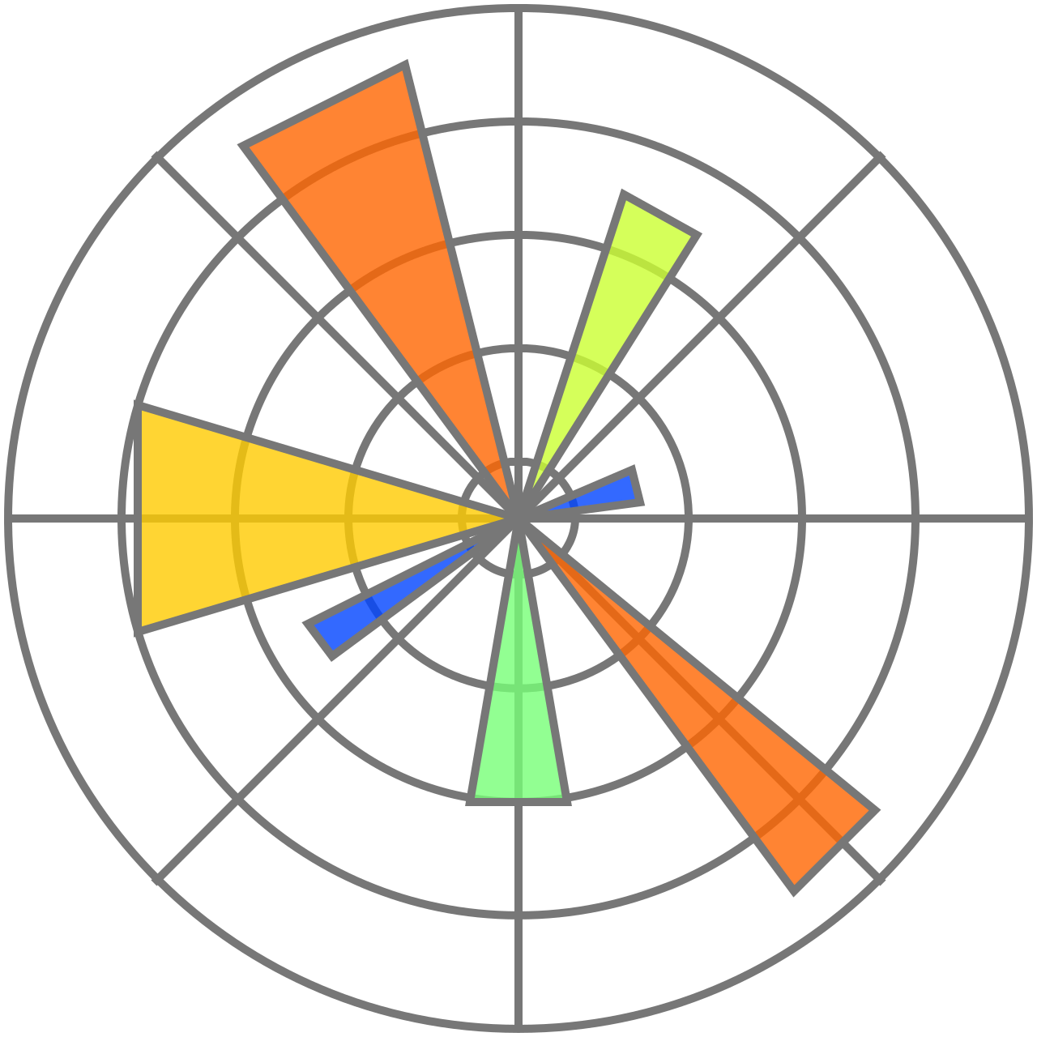
Matplotlib
A plotting library for Python that can easily integrate with Pandas
Offers a wide variety of plot types to choose from
Its plots are easily customizable and exportable
Examples can be viewed here: https://matplotlib.org/stable/plot_types/index.html

Slide 13
Survey of Other Tools
Stanza
https://stanfordnlp.github.io/stanza/sentiment.html
SciKit Learn
https://scikit-learn.org/stable/tutorial/text_analytics/working_with_text_data.html
spaCy (for working with text)
https://spacy.io/usage/models

Slide 14
Survey of Tools (cont’d)
Rozha (for working with text)
https://github.com/ian-nai/Rozha
Demo: https://colab.research.google.com/drive/108FvBVuNllMneNzdNLYSVbu91D2dKcGs?usp=sharing
Beautiful Soup - Python package for parsing HTML and XML documents; useful for web scraping.
https://beautiful-soup-4.readthedocs.io/en/latest/

Slide 15
Thank you!
Contacts:
ian.goodale@austin.utexas.edu
karinasanchez@austin.utexas.edu

Slide 16
Coding Exercise
First, let’s locally install our packages:
pandas
nltk
matplotlib
textblob
wordcloud
Link to Colab notebook: https://colab.research.google.com/drive/1-s0sl27rfuOeR2IWXI6J-Orb4FzXHtvo?usp=sharing

